Slide 1
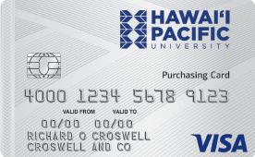
Purchasing Card Training May 2018

Slide 2
Agenda
BAML card distribution and collection of WF card
Card Overview and Transaction Management
Similarities and Enhancements
Activation and PIN selection
Online navigation in Works
Reviewing and reconciling transactions
Approving and flagging transactions
OOP and Mileage reimbursement submission

Slide 3
Reason for transitioning from Wells Fargo
WF has encountered challenges over the past few years. It had to reassess priorities and refocus their line of business across regions in the U.S.
WF determined it would be most beneficial for them to shift focus on operations and strategies to the mainland and opted to end its program with HPU.

Slide 4
Similarities
Visa card, chip and PIN enabled
Uses web browser for online transaction management.
Chart of Accounts and default GL coding were migrated.
Credit limit and approval structure were migrated.

Slide 5
Key enhancements with BAML card
Receipts imaging feature - allows users to upload, store, view and download invoices/receipts.
Review and approval flexibility - allows cardholders and approvers to approve/sign off transactions within the cycle period.
Charge card transactions submission to Business Office is now electronic.
HPU logo feature – perfect timing to display and promote our new logo.

Slide 6
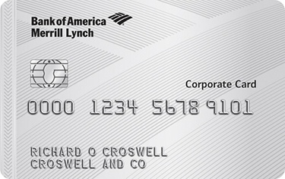
Card Activation and PIN Management
What is needed to activate and self-select a PIN?
Cardholders will need to be aware of key account information, such as:
Verification ID
Zip code - 96813

Slide 7
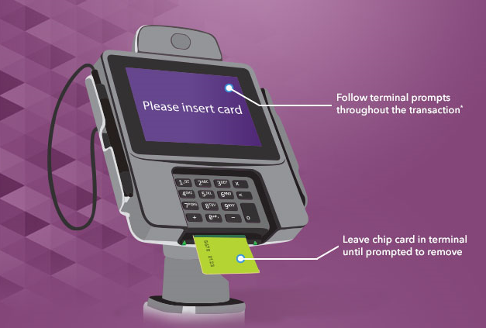
Point of Sale Chip Transactions
For all chip cards, the PIN is stored securely in two places
1. “online PIN”
Card Processor
2. “offline PIN”
They always need to match to allow for efficient use of the card for all chip transactions
The PIN is synced automatically during the first chip card transaction after the Cardholder has customized their PIN
In most cases, this will happen “behind the scenes” after the cardholder enters their new PIN the first try.
In some cases, the cardholder might have to enter their new PIN 3 or 4 tries for it to sync. They will see an initial message that says “invalid PIN”, but they simply should leave their card inserted in the terminal and re-enter their PIN
Once synced after that first transaction, all subsequent chip transactions should work on the first correct PIN entry

Slide 8
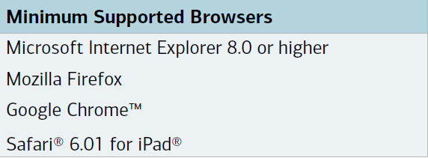
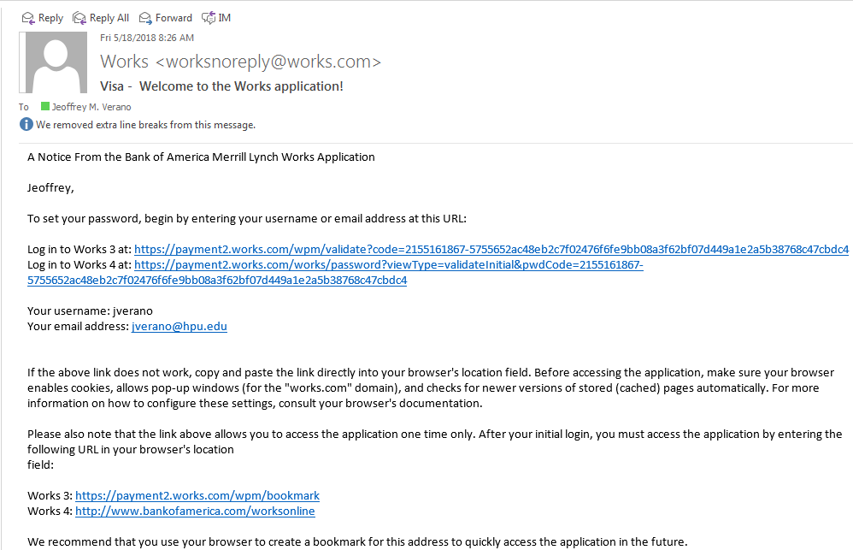
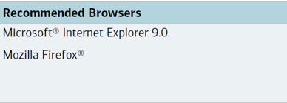

Slide 9
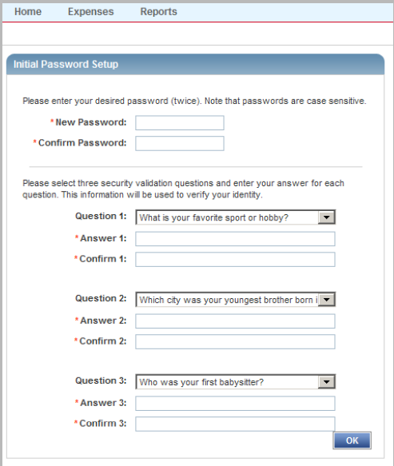
Setting up password and Security Questions
You’ll be prompted to set up your new password and security validation questions.

Slide 10
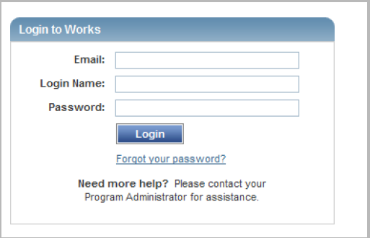
Initial Log in
To log in to Works go to :
payment2.works.com or
www.bankofamerica.com/worksonline

Slide 11
Navigating in Works
Please refer to the attached handouts
To Reconcile Charge Card Transactions
To Approve Charge Card Transactions

Slide 12
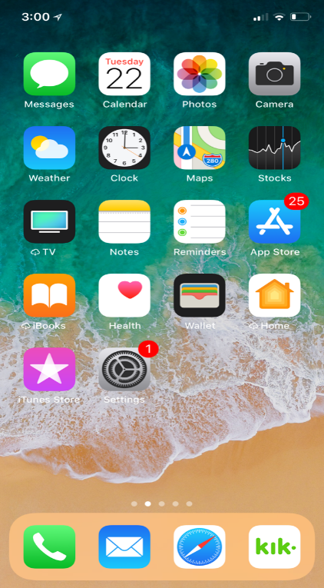
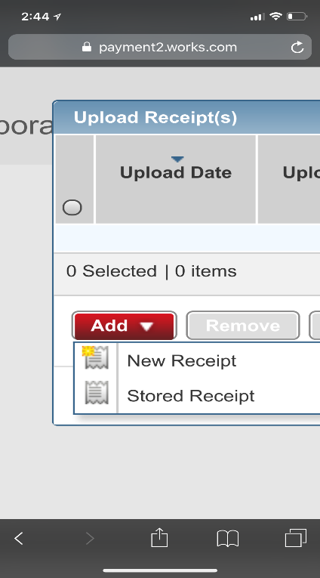
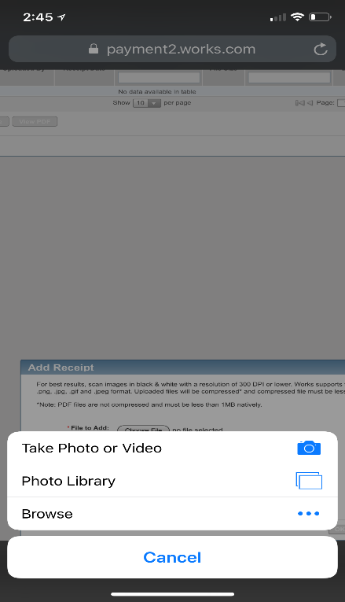
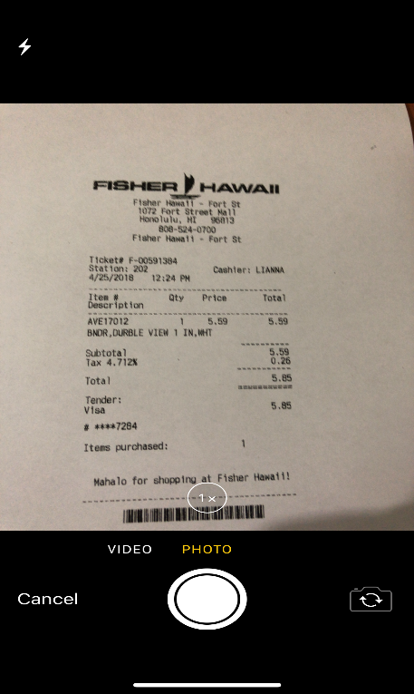
Mobile upload feature
Open a browser from your mobile device and log in to works to upload your receipt – take picture, choose from your photo library or browse in your documents.

Slide 13
Changes
Out of Pocket Reimbursements -
Hard copy submission through Accounts Payable.
Check will be issued rather than ACH credit.
Monthly submission is fine. You don’t have to wait until the PCard cycle ends.
Mileage Reimbursements –
Hard copy submission through Accounts Payable.
Check will be issued rather than ACH credit.
Monthly submission is fine. You don’t have to wait until the PCard cycle ends.

Slide 14
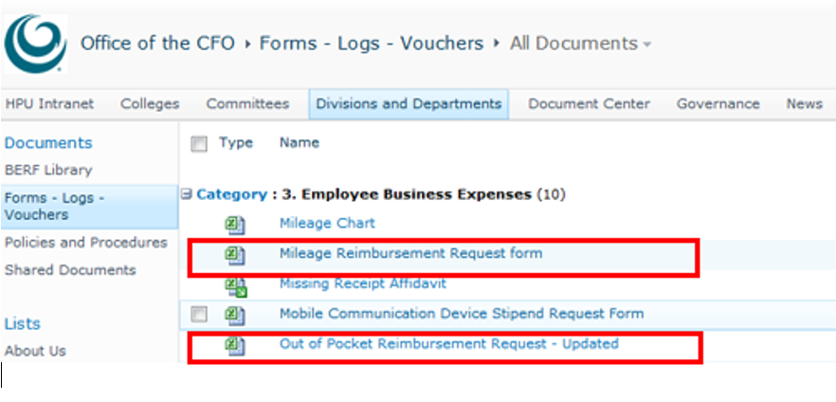
The forms are available online at nexus.hpu.edu, under Divisions and Departments tab, Office of the CFO. Click on Forms – Logs – Vouchers.
https://nexus.hpu.edu/dept/CFO/Forms%20%20Logs%20%20Vouchers/Forms/AllItems.aspx

Slide 15
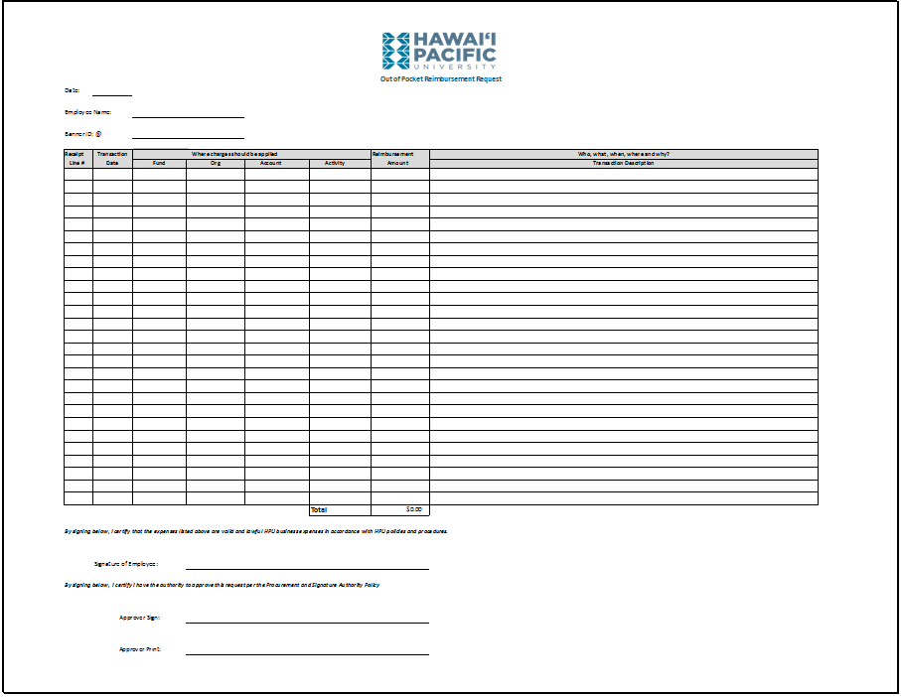
Out of Pocket Reimbursements

Slide 16
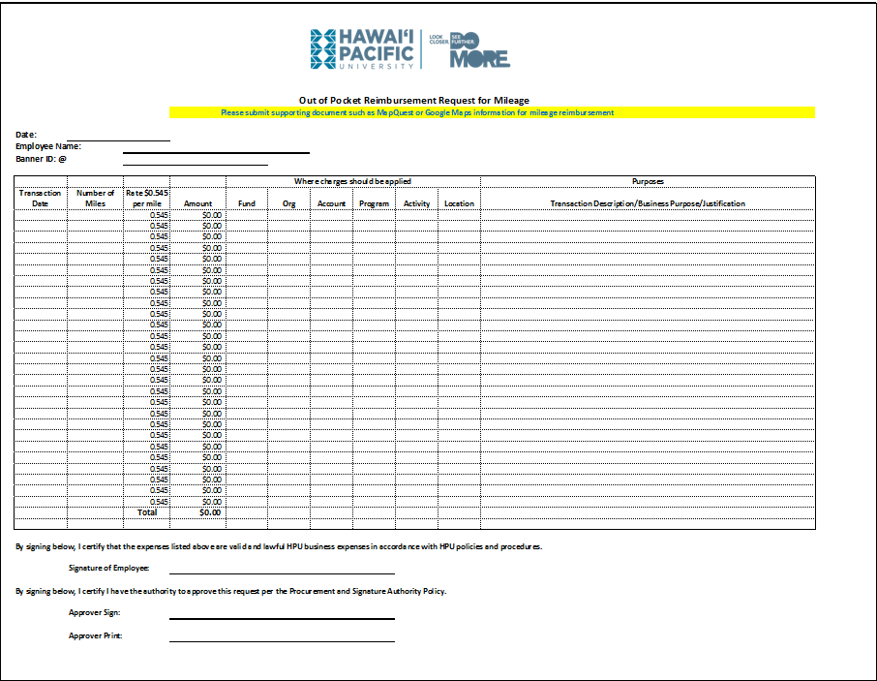
Mileage Reimbursement Request Form

Slide 17
Important Advisory
Please be sure to review and approve all Out-of-Pocket submission in Wells Fargo by May 31, 2018.

Slide 18
Questions
The FAQs is available online at nexus.hpu.edu, under Divisions and Departments tab, Office of the CFO. Click on Forms – Logs – Vouchers.
https://nexus.hpu.edu/dept/CFO/Forms%20%20Logs%20%20Vouchers/Forms/AllItems.aspx

Slide 19
You may contact the AP Team at apfinance@hpu.edu or at 808 356-5271

